Slide 1




Causal Impact Analysis
Customer Value Changing Events: (CeViChE)
Aug 2021

Slide 2
01 Motivations
02 Technical Framework
03 Case Study

Slide 3
Motivation

Slide 4

Motivation | Where AB Test Fails
Although true experiments have higher internal validity, sometimes in reality it’s not feasible (not practical or ethical) to provide or withhold a treatment on a random basis; Causal Impact analysis can allow you to study the same causal relationship as accurately as a controlled experiment.

Slide 5












Motivation | Uber
Cross-sell opportunities are large but require rigor in quantifying the long term monetary impact
Marketers have no way to tie their acquisition efforts to monetary impact for Uber for cross-sell budget planning
Leadership cannot rely on rigorous causality to prioritize between product acquisition
Data Scientists that build cross-sell conversion models cannot measure expected value of a conversion without insight into the value of a conversion

Slide 6
Technical Framework
Scoring, Matching, Inference

Slide 7
Quasi-experimental Designs
Among all the methods, CeViChE uses well established, tunable matching and rigorous inference validation technique
Difference in differences (pre-post with-without comparison)
Nonequivalent control groups design
Regression discontinuity design
Case-control design
time-series designs
multiple time series design
interrupted time series design
propensity score matching
instrumental variables
Panel analysis
CeViChE - Stratified propensity score matching + Meta learners + Sensitivity analysis
Notes:
Reduce the information

Slide 8
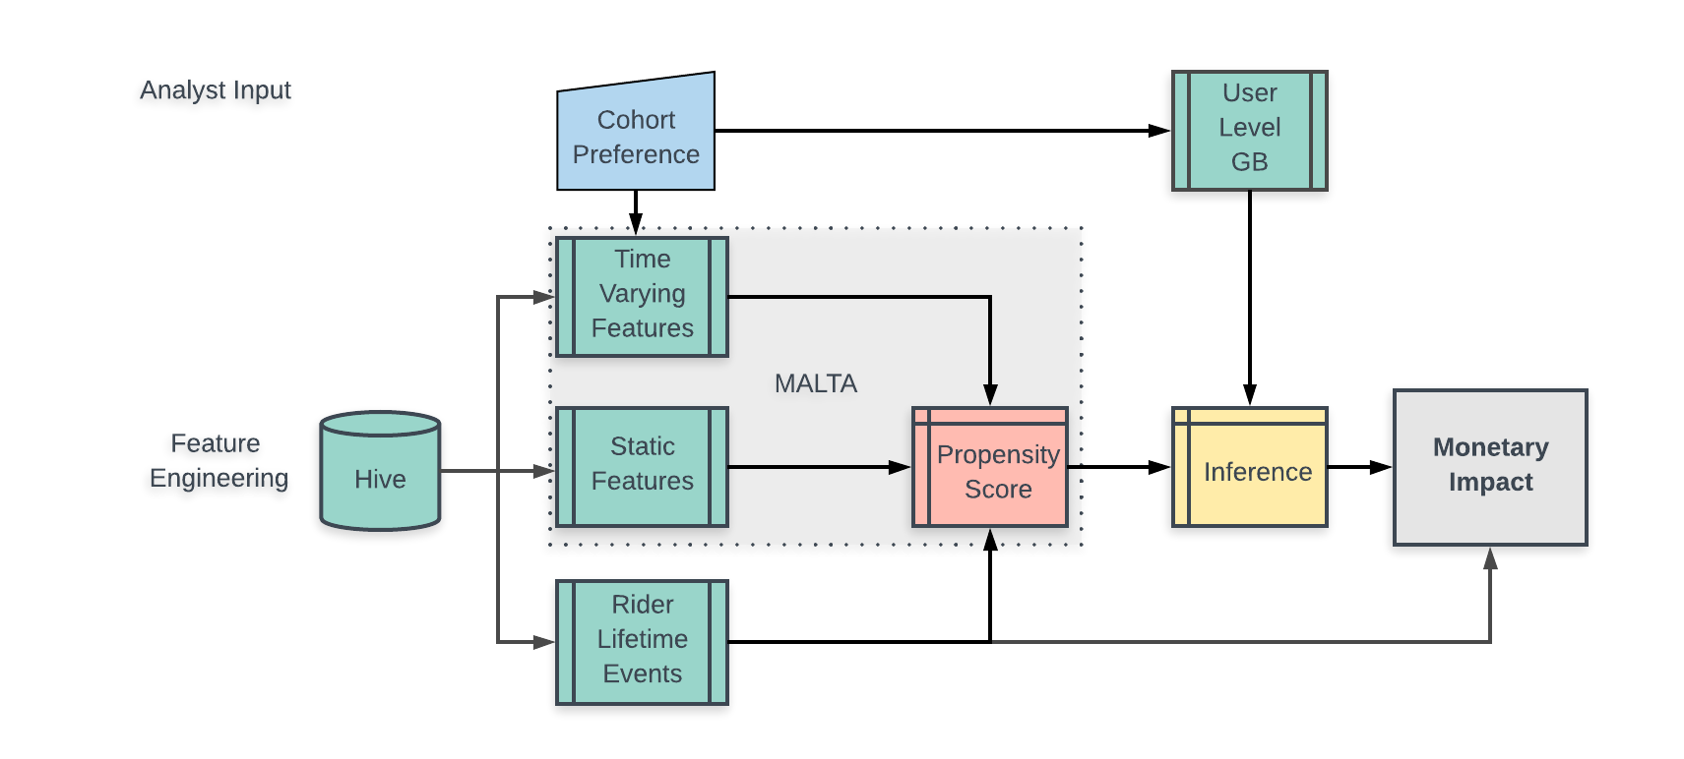
Methodology
Feature Engineering -> Propensity Score -> Matching -> Inference

Slide 9

Methodology
Propensity Score Matching: Homogeneous group creation from observation data
Methodology
Propensity score matching*: User-level matching procedure to ensure T/C groups are as similar as possible.
Propensity score reflects each user’s characteristics and past behaviours.
Perform a nearest neighbor matching based on propensity score.
Optimize the matching results by adding matching covariates together with propensity score into matching.
Verify similarity of feature distributions between treatment and control after matching.
Notable points
Add calipers to define the maximum threshold for difference.
* As in any observational study, there may still exist hidden confounders that influence both the conversion behavior and the potential outcomes. We try to be comprehensive in the feature list for the matching to remove the bias as much as we can.

Slide 10
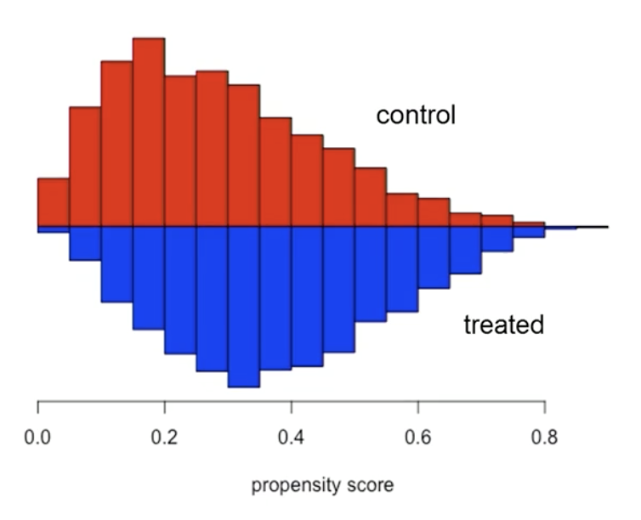
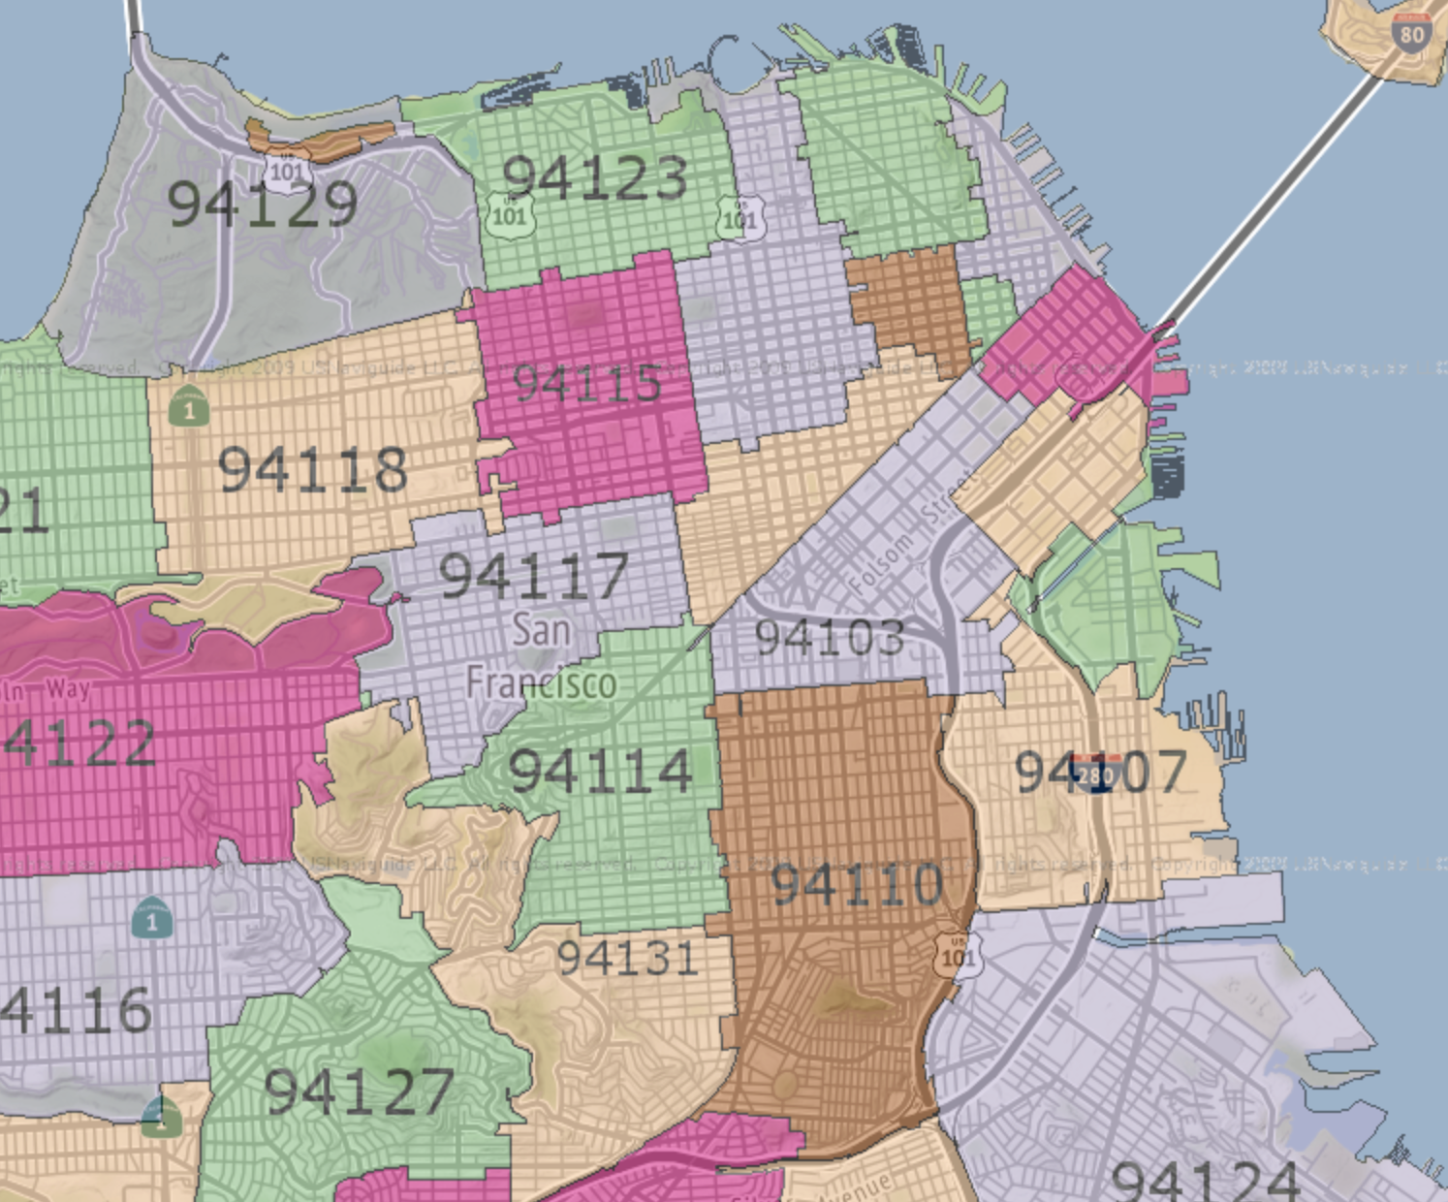
Methodology
Propensity Score Matching on Zip Code Level
...
Propensity Score Model
Group users by zip codes
Propensity Score Matching by zip codes

Slide 11
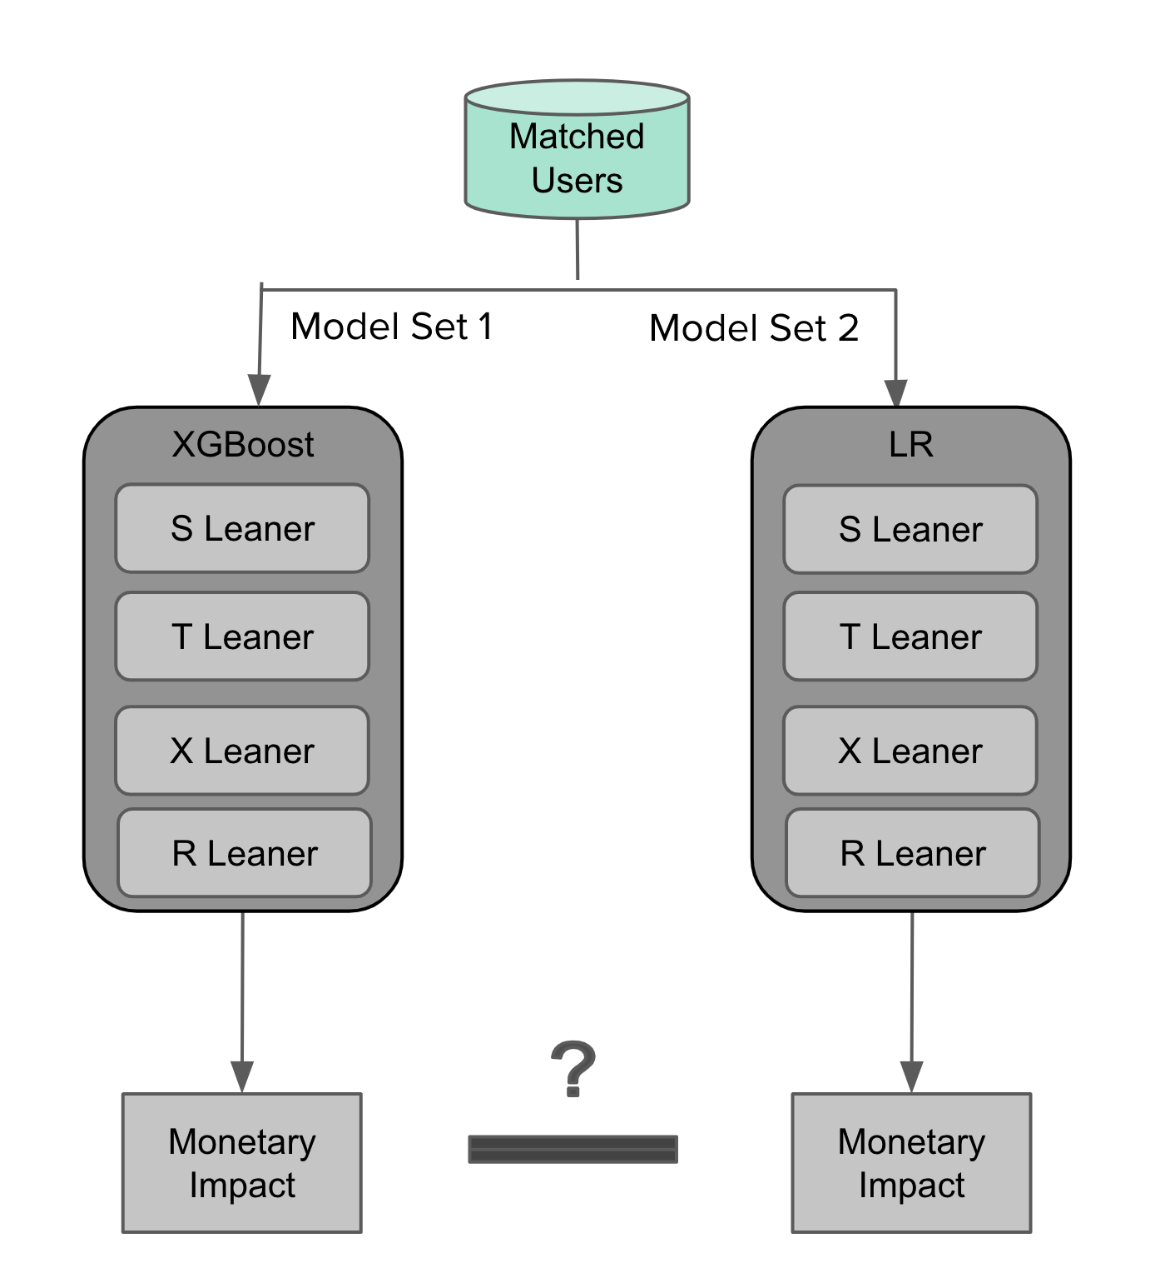
Methodology
Inference: Leveraging different methods to validate inference
Apply models on the matched dataset to estimate Average Treatment Effect. This process is cross- validated by various algorithms and time frames.
Meta-learner algorithms^{[1], [2]} as the main inference model to estimate the impact of the conversion event on gross bookings.
S Learner
T Learner
X Learner
R Learner
Evaluate the inference validity by two sets of models using XGBoost and Linear Regression as base learner.
[1] Kunzel S, Sekhon J, Bickel P, Y Bin. “Meta-learners for Estimating Heterogeneous Treatment Effects using Machine Learning”, arXiv preprint arXiv:1706.03461.
[2] Alaa A, van der Schaar M. “Limits of Estimating Heterogeneous Treatment Effects: Guidelines for Practical Algorithm Design”, AAAI 2018.

Slide 12
Case Study
Monetary Impact of Rider to Eater (R2E) Cross Sell

Slide 13




Analysis Setup
Pre-Treatment
Period
(3 Mon)
Treatment
Period
(3 Mon)
Post-Treatment
Period
(3 Mon)
Treatment
Group
Control
Group
Feature
Collection
Treatment
Observation
GB
Observation
Treatment Group: Riders who converted to Eaters within treatment period
Control Group: Riders who were not converted to Eaters until the end of post-treatment period

Slide 14

Propensity Score Matching
Matching removes biases between treatment and control
Before matching |  | After matching
Treatment: R2E Conversion | 4K users 3 Mon GB*: $2,000 3 Mon Trips: 100 | Treatment: R2E Conversion | 4K users 3 Mon GB: $2,000 3 Mon Trips: 100
Control: No R2E | 96K users 3 Mon GB: $20 3 Mon Trips: 10 | Control: No R2E | 4K users 3 Mon GB: $2,000 3 Mon Trips: 100
* Number here just for illustration purpose not from the real Uber Rider datasets

Slide 15
Matching Validation
Standard Mean Difference (SMD) on observed covariates, with |SMD| < 0.1 considered balanced
 | Pre-Matching |  |  | After-Matching
Variable | Control | Treatment | SMD | Control | Treatment | SMD
n | 96k | 4k |  | 96k | 4k
feature_1 | 0.11 (0.17) | 0.30 (0.13) | 1.248 | 0.30 (0.13) | 0.30 (0.13) | 0.000
feature_2 | 62.99 (137.07) | 17.28 (51.43) | -0.442 | 16.94 (51.15) | 17.28 (51.43) | 0.007
feature_3 | 0.53 (1.84) | 2.14 (3.57) | 0.568 | 2.14 (3.57) | 2.14 (3.57) | -0.001
feature_4 | 0.87 (1.49) | 1.97 (2.98) | 0.470 | 1.99 (3.02) | 1.97 (2.98) | -0.005
feature_5 | 0.80 (3.18) | 3.61 (7.87) | 0.467 | 3.53 (7.73) | 3.61 (7.87) | 0.009
feature_6 | 0.08 (0.12) | 0.31 (0.17) | 1.538 | 0.31 (0.17) | 0.31 (0.17) | 0.000
fefeature_7 | 1.76 (2.21) | 4.60 (1.71) | 1.435 | 4.62 (1.69) | 4.60 (1.71) | -0.011
... | ... | ... | ... | ... | ... | ...
50+ covariates:
Static,
LTV,
Trips/Orders, Marketing, Comms, Promo

Slide 16
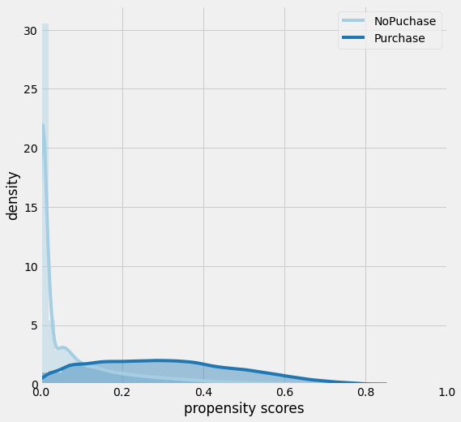
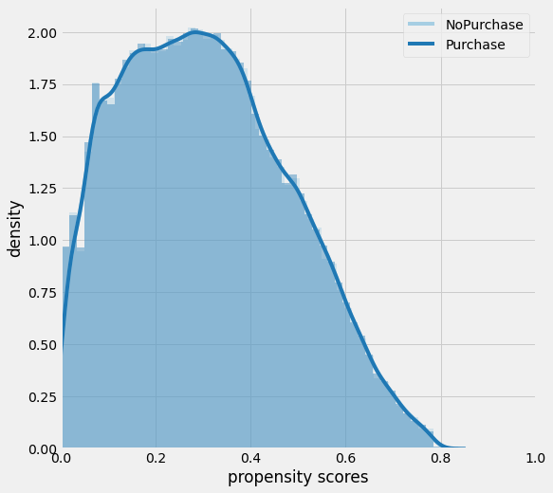
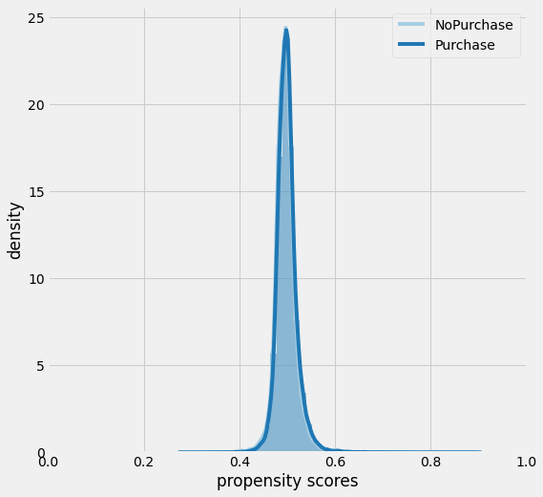
Matching Validation
Density Plot of Propensity Score before Matching
Density Plot of Propensity Score after Matching
Density Plot of Propensity Score after Recalibrating

Slide 17
Sensitivity Analysis
Placebo Treatment
Replace the treatment with a random variable, then retrain the meta-learners
Replace/Add Irrelevant Confounder
Add/replace a random variable to introduce noise to the system, then retrain the meta-learners
Subset Validation
Remove a random subset of the data, then retrain the meta-learner
Selection Bias^{[1]}
One Sided confounding function and Alignment confounding function
[1] Blackwell, Matthew. "A selection bias approach to sensitivity analysis for causal effects." Political Analysis 22.2 (2014): 169-182.

Slide 18
Q&A

Slide 19
Appendix

